Slide 1
R
Time series

Slide 2
Prediction & Forecasting
Time Series Modeling
it involves working on time (years, days, hours, minutes) based data, to derive hidden insights to make informed decision making.

Slide 3
stationary series,
random walks ,
Rho Coefficient,
Dickey Fuller Test of Stationarity.

Slide 4
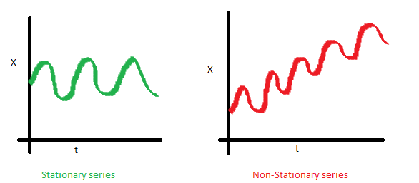

Slide 5
The variance of the series should not a be a function of time. This property is known as homoscedasticity.
until unless your time series is stationary, you cannot build a time series model.

Slide 6
Detrending, Differencing

Slide 7
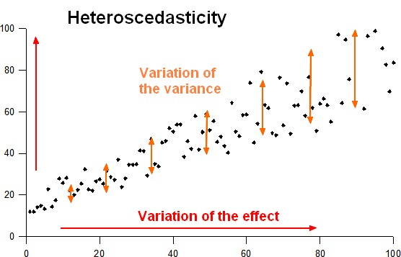

Slide 8

Random Walk
random walk is not a stationary process as it has a time variant variance
Introduced coefficient : Rho
we will vary the value of Rho to see if we can make the series stationary.

Slide 9
Dickey Fuller Test of Stationarity
Stationary testing and converting a series into a stationary series are the most critical processes in a time series modelling.
Rho = 1
Rho = -1

Slide 10
R code
AirPassengers
summary(AirPassengers)
frequency(AirPassengers)
class(AirPassengers)
plot(AirPassengers)
abline(reg=lm(AirPassengers~time(AirPassengers)))

Slide 11
cycle(AirPassengers)
plot(aggregate(AirPassengers,FUN=mean))
boxplot(AirPassengers~cycle(AirPassengers))

Slide 12
ARMA
AR stands for auto-regression and MA stands for moving average
next instance is solely dependent on the previous instance
Seasonal Growth like for Juice, ice cream

Slide 13
Moving Average
A manufacturer produces a certain type of bag, which was readily available in the market. Being a competitive market, the sale of the bag stood at zero for many days. So, one day he did some experiment with the design and produced a different type of bag. This type of bag was not available anywhere in the market. Thus, he was able to sell the entire stock of 1000 bags (lets call this as x(t) ). The demand got so high that the bag ran out of stock. As a result, some 100 odd customers couldn’t purchase this bag. Lets call this gap as the error at that time point. With time, the bag had lost its woo factor. But still few customers were left who went empty handed the previous day.

Slide 14
Is it an AR or MA process?
What order of AR or MA process do we need to use?
Auto – correlation Function – ACF
partial correlation function (PACF)

Slide 15
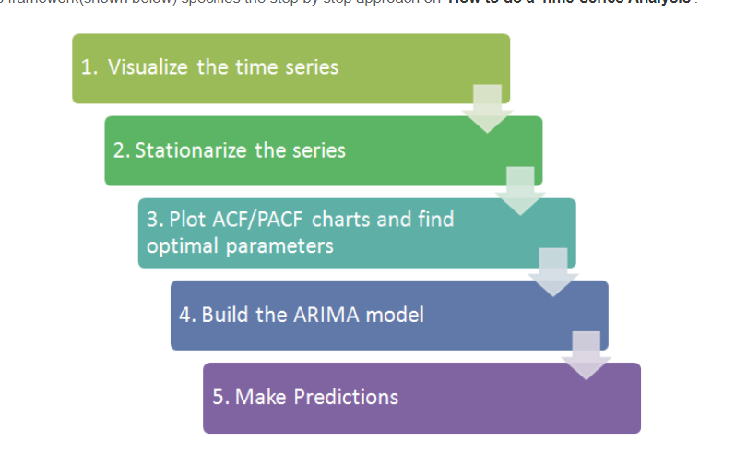
ARIMA

Slide 16
There are three commonly used technique to make a time series stationary:
Detrending
Differencing
Seasonality
The parameters p,d,q can be found using ACF and PACF plots

Slide 17
if both ACF and PACF decreases gradually, it indicates that we need to make the time series stationary and introduce a value to “d”.
Build ARIMA Model
Make Predictions

Slide 18
Augmented Dickey-Fuller Test
Adf.test()
install.packages("tseries")
library(tseries)
adf.test(diff(log(AirPassengers)), alternative="stationary", k=0)

Slide 19
Augmented Dickey-Fuller Test data:
diff(log(AirPassengers))
Dickey-Fuller = -9.6003, Lag order = 0, p-value = 0.01
alternative hypothesis: stationary

Slide 20
find the right parameters to be used in the ARIMA model
adf.test(diff(log(AirPassengers)), alternative="stationary", k=0)
acf(log(AirPassengers))

Slide 21
> pacf(diff(log(AirPassengers)))
> acf(diff(log(AirPassengers)))
(fit <- arima(log(AirPassengers), c(0, 1, 1),seasonal = list(order = c(0, 1, 1), period = 12)))
pred <- predict(fit, n.ahead = 10*12)
ts.plot(AirPassengers,2.718^pred$pred, log = "y", lty = c(1,3))

Slide 22
AIC
BIC

Slide 23
trend, seasonality and error
How to extract the trend, seasonality and error?
The decompose() and forecast::stl() splits the time series Into
seasonality,
trend
and error components.

Slide 24
tsData <- EuStockMarkets[, 1] # ts data
decomposedRes <- decompose(tsData, type="mult") # use type = "additive" for additive components
plot (decomposedRes) # see plot below
stlRes <- stl(tsData, s.window = "periodic")

Slide 25
create lags of a time-series
laggedTS <- lag(tsData, 3)
# shifted 3 periods earlier. Use `-3` to shift by 3 periods forward.

Slide 26
library(DataCombine)
myDf <- as.data.frame(tsData)
myDf <- slide(myDf, "x", NewVar = "xLag1", slideBy = -1) # create lag1 variable
myDf <- slide(myDf, "x", NewVar = "xLead1", slideBy = 1) # create lead1 variable
head(myDf)

Slide 27
Autocorrelation is the correlation of a Time Series with lags of itself.
It shows if the previous states (lagged observations) of the time series has an influence on the current state. In the autocorrelation chart, if the autocorrelation crosses the dashed blue line, it means that specific lag is significantly correlated with current series. For example, in autocorrelation chart of AirPassengers - the top-left chart (below), there is significant autocorrelation for all the lags shown on x-axis.

Slide 28
autocorrelation
It is used commonly to determine if the time series is stationary or not. A stationary time series will have the autocorrelation fall to zero fairly quickly but for a non-stationary series it drops gradually.

Slide 29
Partial Autocorrelation is the correlation of the time series with a lag of itself, with the linear dependence of all the lags between them removed.

Slide 30
# both acf() and pacf() generates plots by default
acfRes <- acf(AirPassengers) # autocorrelation
pacfRes <- pacf(AirPassengers) # partial autocorrelation
ccfRes <- ccf(mdeaths, fdeaths, ylab = "cross-correlation") # computes cross correlation between 2 timeseries.
head(ccfRes[[1]])

Slide 31
trModel <- lm(JohnsonJohnson ~ c(1:length(JohnsonJohnson)))
plot(resid(trModel), type="l") # resid(trModel) contains the de-trended series.

Slide 32
de-seasonalize
Step 1: De-compose the Time series using forecast::stl()
Step 2: use seasadj() from ‘forecast’ package

Slide 33
library(forecast)
ts.stl <- stl(TS,"periodic") # decompose the TS
ts.sa <- seasadj(ts.stl) # de-seasonalize
plot(AirPassengers, type="l") # original series
plot(ts.sa, type="l") # seasonal adjusted
seasonplot(ts.sa, 12, col=rainbow(12), year.labels=TRUE, main="Seasonal plot: Airpassengers") # seasonal frequency set as 12 for monthly data.

Slide 34
How to test if a time series is stationary?
Use Augmented Dickey-Fuller Test (adf test). A p-Value of less than 0.05 in adf.test() indicates that it is stationary.
library(tseries)
adf.test(tsData) # p-value < 0.05 indicates the TS is stationary
kpss.test(tsData)

Slide 35
How to make a time series stationary?
Differencing a time series means, to subtract each data point in the series from its success
How to know how many differencing is needed? the nsdiffs and ndiffs from forecast package can help find out how many seasonal differencing and regular differencing respectively is needed to make the series stationary.

Slide 36
# Seasonal Differencing
nsdiffs(AirPassengers) # number for seasonal differencing needed
#> 1
AirPassengers_seasdiff <- diff(AirPassengers, lag=frequency(AirPassengers), differences=1) # seasonal differencing
plot(AirPassengers_seasdiff, type="l", main="Seasonally Differenced") # still not stationary!

Slide 37
# Make it stationary
ndiffs(AirPassengers_seasdiff) # number of differences need to make it stationary
#> 1
stationaryTS <- diff(AirPassengers_seasdiff, differences= 1)
plot(stationaryTS, type="l", main="Differenced and Stationary") # appears to be stationary

Slide 38
births <- scan("http://robjhyndman.com/tsdldata/data/nybirths.dat")
birthstimeseries <- ts(births, frequency=12, start=c(1946,1))
Birthstimeseries
plot.ts(birthstimeseries)

